Slide 1


Slide 2
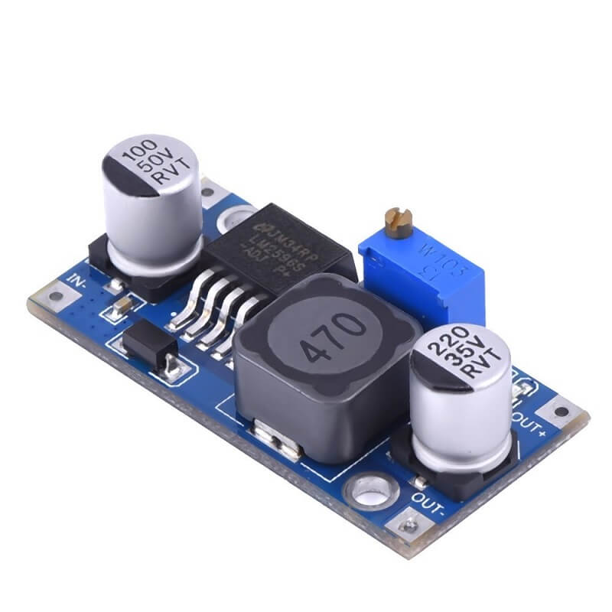
Group 4
BUCK CONVERTER
DC to DC converter
02
EE-37-LINEAR CONTROL SYSTEMS

Slide 3
Project Details
Project Supervisor:
Dr. Fareed Gul
Group members: (4th Grp)
01
Muhammad Hamza
02
03
04
03
290951
286021
Ch. Muhammad Shaheer Yasir
284634
Qadoom Abdullah
291898
Muhammad Ibrahim

Slide 4
TABLE OF CONTENTS
INTRODUCTION
DESIGN SPECS
01
02
SIMULATIONS
CONCLUSIONS
03
04
04
Preface
Definition
Working
Given and assumed specs
PID Specs
SIMULINK CIRCUIT
Transfer Function
Bode Plots
Results
Cost of Implementation
Limitations
Advantages/Uses

Slide 5
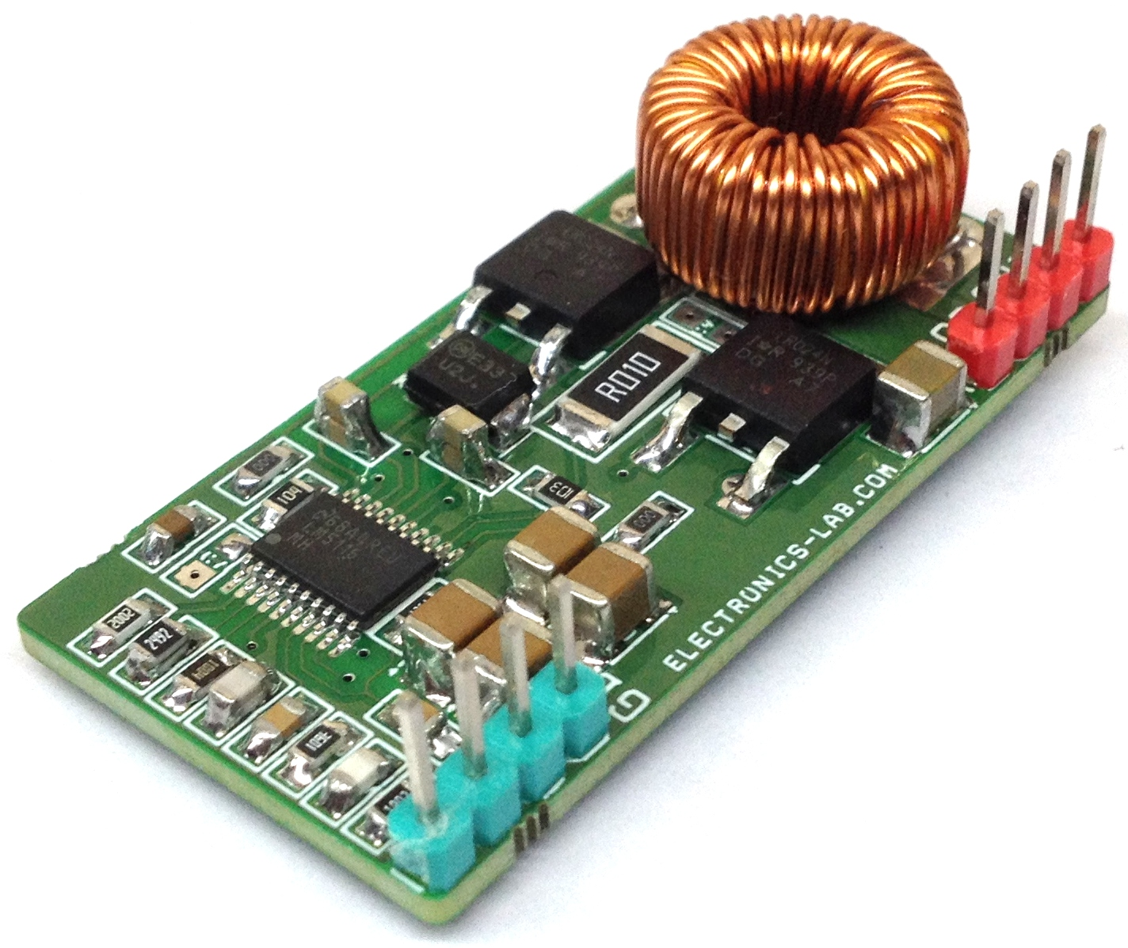
PREFACE:
05
This project is about Buck Converter which is a DC-DC converter which will step down a higher voltage to a lower voltage level i.e lesser magnitude
The DC input can be derived from rectified AC or from any DC supply.
The Buck Converter produces voltage ranging from the input voltage to down to Zero voltage.
It is widely used throughout the industry to convert higher DC input voltage into lower DC output voltage.

Slide 6
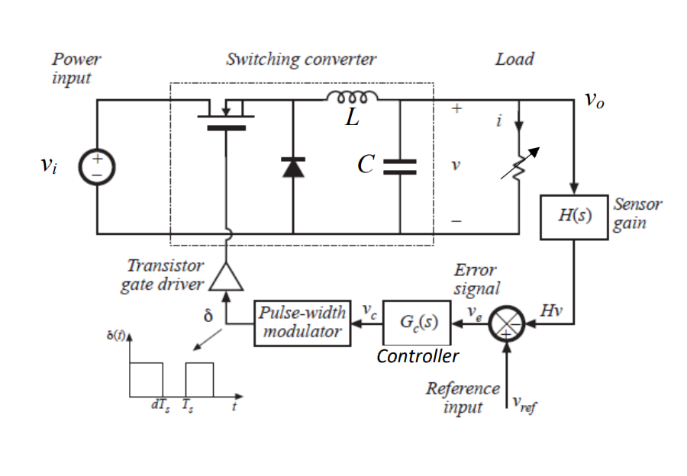
WHAT IS BUCK CONVERTER?
06
It uses a power semiconductor device as a switch to turn on and off the DC supply to the load.
The switching action can be implemented by a BJT, a MOSFET, or an IGBT.
A simplified buck uses pulse-width modulation (PWM) of switching frequency to control the switch.
An external diode, together with external inductor and output capacitor, produces the regulated dc output.
Buck, or step down converters produce an average output voltage lower than the input source voltage.

Slide 7
WORKING
07
. The circuit operation depends on the conduction state of the MOSFET:
On-state: The current through the inductor increases and the diode blocks.
Off-state: Since the current through the inductor cannot abruptly change the diode must carry the current so it commutates and begins conducting. Energy is transferred from the inductor to the capacitor resulting in a decreasing inductor current.
During steady state the circuit is said to operate:
in discontinuous conduction mode if the inductor current reaches zero and
in continuous conduction mode if the inductor current never reaches zero.
For a PWM cycle ,current➝ 0 the output voltage equals zero, and for current flowing the output voltage equals V_{in}. In between those limits the output voltage in continuous conduction mode.

Slide 8
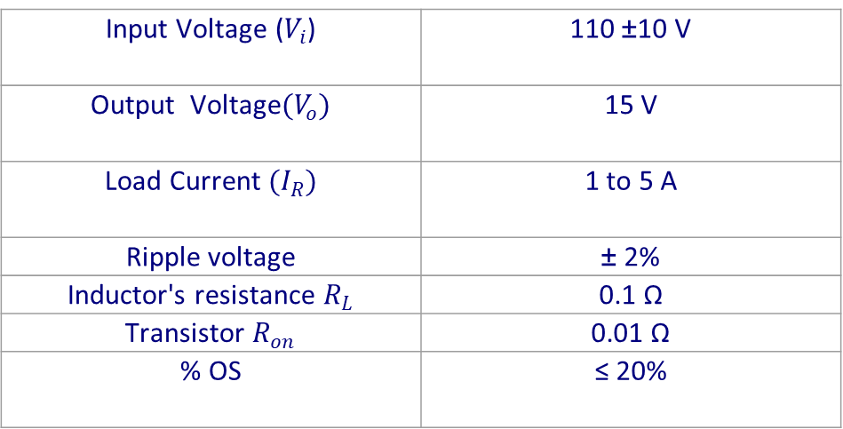
DESIGN SPECIFICATIONS
08
Input Voltage ($V_{i}$) | 110 ±10 V
Output Voltage$(V_{o})$ | 15 V
Load Current $(I_{R})$ | 1 to 5 A
Ripple voltage | ± 2%
Inductor's resistance $R_{L}$ | 0.1 Ω
Transistor $R_{on}$ | 0.01 Ω
% OS | ≤ 20%

Slide 9
ASSUMED SPECS
09
Using presets Built-in Blocks in Simulink with given specifications and assuming following specifications as following and measuring the outputs using scope. By varying load i.e, values of inductor, capacitor and resistances the output load shows very little fluctuation. Hence , providing a constant dc voltage at the output.
Capacitance Used:
Capacitance (uF) = 10
Load Resistance:
Resistance (Ω) = 10
Inductor with its resistance:
Inductance (H) :30e-3
Resistance (ohm): 0.1

Slide 10
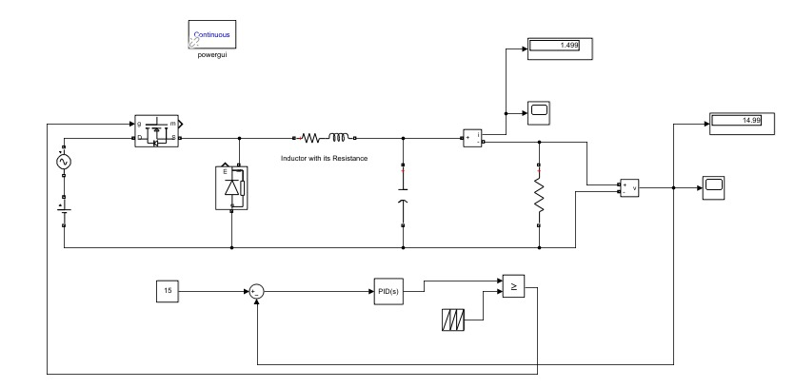
Simulink Circuit:
10

Slide 11
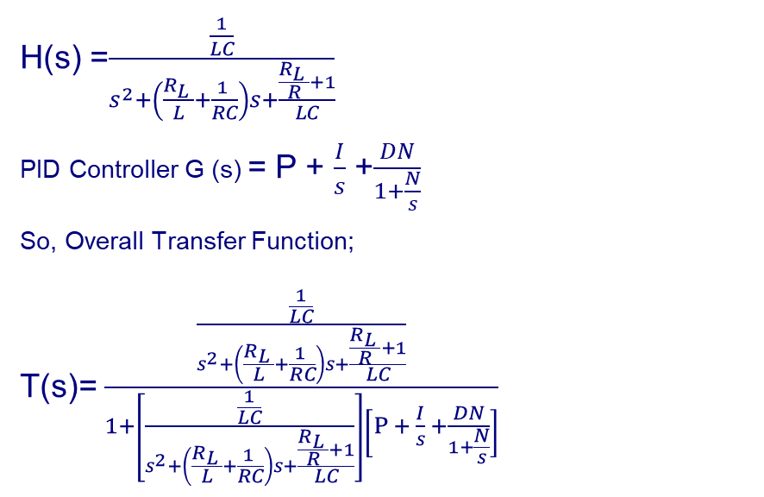
Transfer Function:
11
H(s) =$\frac{\frac{1}{LC}}{s^{2}+\left(\frac{R_{L} }{L}+\frac{1 }{RC}\right)s+\frac{\frac{R_{L} }{R}+1}{LC}}$
PID Controller G (s) = P + $\frac{I}{s}$ +$\frac{DN}{1+\frac{N}{s}}$
So, Overall Transfer Function;
T(s)=$\frac{\frac{\frac{1}{LC}}{s^{2}+\left(\frac{R_{L} }{L}+\frac{1 }{RC}\right)s+\frac{\frac{R_{L} }{R}+1}{LC}}}{1+\left[\frac{\frac{1}{LC}}{s^{2}+\left(\frac{R_{L} }{L}+\frac{1 }{RC}\right)s+\frac{\frac{R_{L} }{R}+1}{LC}}\right]\left[P + \frac{I}{s} +\frac{DN}{1+\frac{N}{s}}\right]}$

Slide 12

Transfer Function:
11
T(s)=$\frac{sR}{s^{3}+s^{2}\left(R_{L}RC+L\right)+s(R_{L}+RP)+RI}$
T(s)=$\frac{s(10)}{s^{3}\left(10)((30e−3)(10e−6+L\right)+s^{2}\left(0.1x10)((10e−6 x10e−6+30e−3\right)+s\left(0.1+10+100 x 10\right)+10x 20}$
T(s)=$\frac{10s}{\left(3e−6\right)s^{3}+s^{2}\left(0.030001\right)+s\left(1010.1\right)+200}$

Slide 13
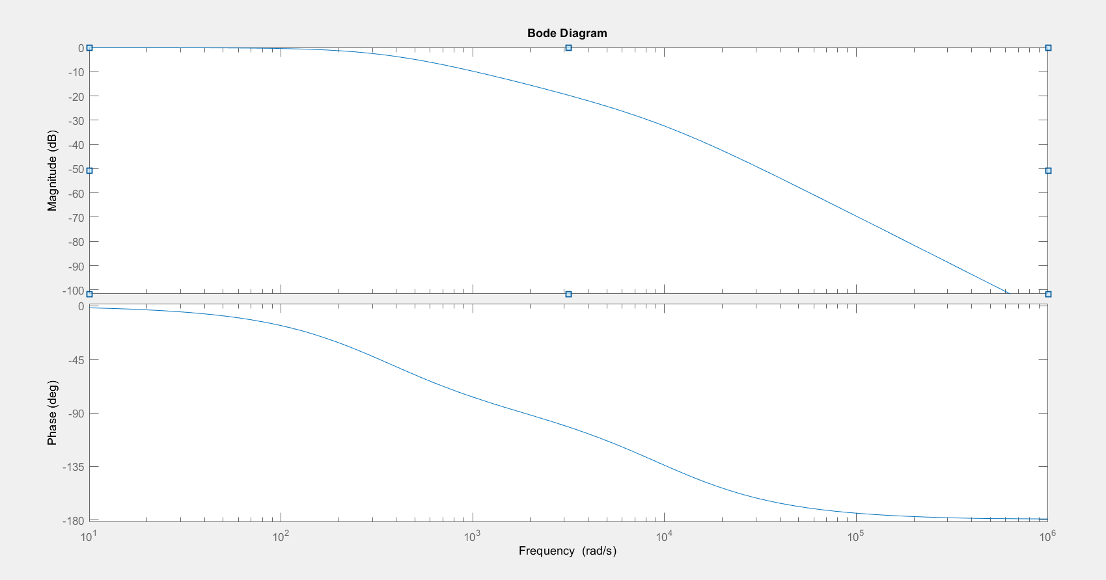
Bode Plot:
12
Bode plot without feedback:

Slide 14
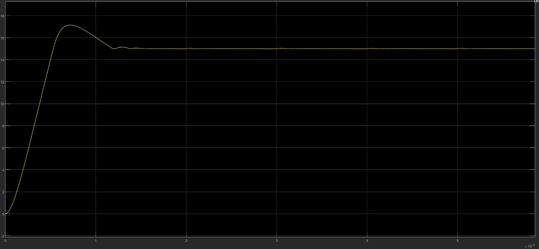

$V_{o}$ Plot:
13

Slide 15
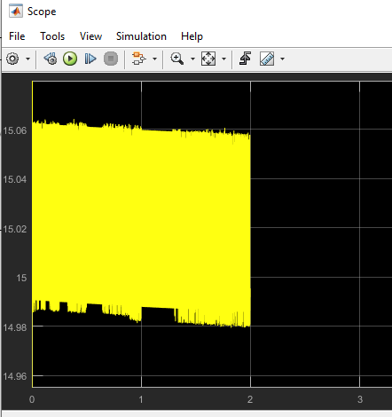
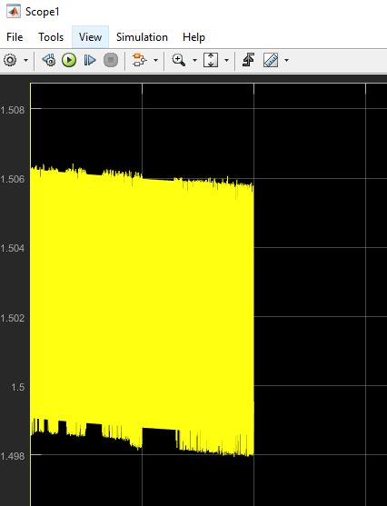
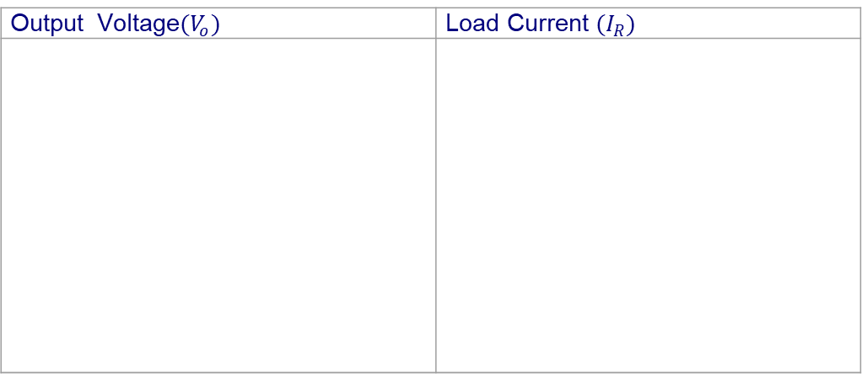
RESULTS:
14
Overshoot :14.6 % < 20 % which is acceptable according to our design specs.
Ripple Voltage: 0.4 % < 2% which is acceptable according to our design specs.
Output Voltage$(V_{o})$ | Load Current $(I_{R})$

Slide 16
Cost of Implementation:
15
Diode Rs.60
P-channel Mosfet(IRF9540) Rs.100
PID CONTROLLER Rs.2860
(Inductor,resisor,capacitor) Rs.100
Comparators Rs.60
Connecting Wires Rs 50
TOTAL COST: Rs 3130 (approx.)

Slide 17
Advantages w.r.t Types:
16
There are two types of DC/DC converters:
Linear :
A linear DC/DC converter uses a resistive voltage drop to create and regulate a given output voltage,
Switched.
A switched-mode DC/DC converts by storing the input energy periodically and then releasing that energy to the output at a different voltage
They are noisy as compared to a linear circuit and require energy management in the form of a control loop except modern switching-mode controllers.

Slide 18
Limitations:
17
A buck converter converts higher voltages to lower. It’s more efficient and simpler circuitry than a boost converter, but cannot produce a higher output than input.
Although the constructed current design operated as expected, we encountered difficulties in obtaining the converter’s output voltage and current values particularly inductors and resistances values.
This is mainly due to the limited research at first. Overall, our design for the project proved to be successful in demonstrating the ability to perform current function which is crucial in providing safe operation of DC-DC converters.

Slide 19
CONCLUSION:
18
From the simulation results it is found that in case of the buck converters, the desired output voltages can be obtained by selecting proper values of inductor, capacitor and switching frequency.
All of these individual theories were difficult for anyone to grasp primarily and putting them collectively in the simulator which was extremely puzzling. But it has been done most excellently to formulate an outstanding scheme dissertation with affluent in its contest.
At each stage, targets were set to acquire the necessary skills to meet the criteria of the project and design the circuits for implementation in the software willing to implement in hardware.
This project gives the opportunity to study new skills and raise valuable knowledge in circuit designing and problem solving skills which has greatly enriched knowledge and understanding through the erudition route which may help one in for the further progression.

Slide 20
REFERENCES:
19
https://www.youtube.com/watch?v=BPs5xI9GKFU&t=36s
https://www.mathworks.com/help/physmod/sps/ug/buck-converter.html
https://www.youtube.com/watch?v=wTJWtaEh_RM

Slide 21
THANK YOU!
20

